Slide 1



OCEAN e-Referrals
Referral Sources
Presented by Becky Sottana
Fall 2024

Slide 2
WHY
OCEAN?
Ocean is a secure, web-based eReferral Platform
Future integration with the most common EMRs including MEDITECH and EPIC
Funded by the Ministry of Health through the Digital Health Initiative
“Axe the Fax” – secure, legible, no lost referrals
Well established product
Secure instant messaging embedded in eReferral; eliminates phone tag and emailing back and forth
Works on any browser

Slide 3
WHY OCEAN?
Rehabilitation Advisory Committee has committed to using eReferral for all of Champlain region
Ocean was determined by Ontario Health to meet the needs of Subacute sites
Co-locate all incoming referrals for all inpatient Bruyère programs, The Rehabilitation Centre and Hospice-Palliative Care
Proven success with OCEAN receiving referrals for inpatient programs at Bruyère from The Ottawa Hospital, Queensway Carleton and Montfort Hospitals since Spring 2024; Ontario Health atHome added in October 2024
Have received and triaged > 2000 referrals since April 2024

Slide 4
SETTING UP OCEAN ACCOUNTS
Each hospital/organization will have 1+ Site Administrator who is responsible to setup the group site and for sending invitations to their users
Send eReferrals!
Individual users setup personal Ocean account and join the group site
If your site has not yet identified a Site Admin – please contact Becky to up setup a time to meet before Nov 27th.

Slide 5
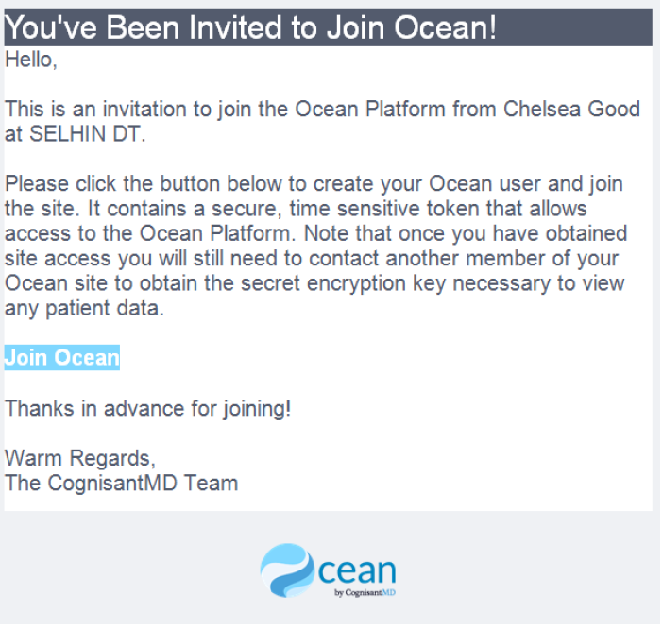
ACCEPTING YOUR INVITATION
Your site admin will invite you to Ocean; after being invited, you will receive an email with instructions for joining Ocean.
Select the “Join Ocean” button within your invitation email.

Slide 6
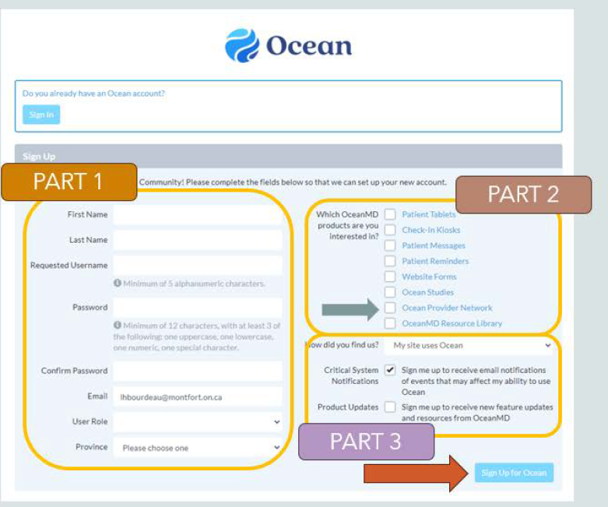
HOW DO I GET AN ACCOUNT?
Using the invite your site administrator has sent, click link and follow instructions
Part 1: complete all the fields. Your password must be a minimum of 12 characters, 1 uppercase, 1 lower case, 1 number and 1 special character
Part 2: Click Ocean Provider Network
Part 3: Complete the fields as shown
Sign Up
You will receive a verification email to verify your email address – you must do that prior to signing in for the first time

Slide 7
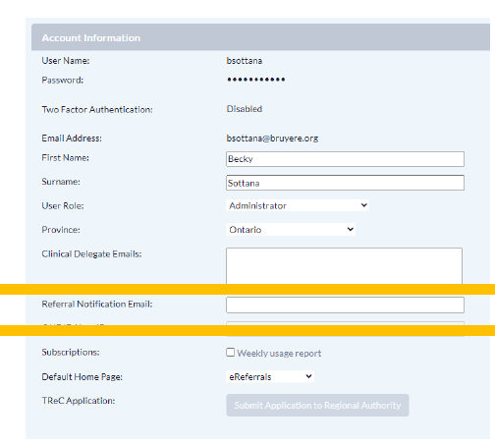
Settings
Users will need to change a few settings
Once logged in, click on your name, then User Settings, My Account
Add your email address in the “Referral Notification Email” section – you will receive notifications that there is a new instant message for you to review.

Slide 8
Settings Cont’d
Under Edit Clinical Contact Information tab
Add 6 dashes (-)under Billing# and 5 dashes (-) under Professional ID
Add Clinic Location

Slide 9
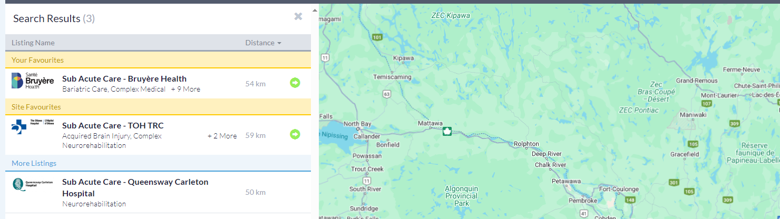
WHAT DOES OCEAN LOOK LIKE WHEN I LOG ON?
“Healthmap”

Slide 10
WHAT PROGRAMS CAN I REFER TO?
Once logged in, review the Healthmap which shows all the sites and programs in the region that are accepting OCEAN eReferrals
By clicking on the site, you can see contact information, which programs they offer and a link to send a referral
Bruyère hosts 2 sites for inpatient services:
  Sub Acute Care
  Hospice-Palliative Care
TOH hosts 1 site for inpatient services:
  Sub Acute Care – TOH TRC

Slide 11
PROGRAMS
Bruyère Health – Inpatient Programs
Geriatric Rehabilitation
Stroke Rehabilitation
Transitional Care
Low Intensity Rehab
Wound Care
Complex Medical
Specialized Complex
Neuromuscular Ventilation
Dialysis
Palliative Care
The Rehabilitation Centre – Inpatient Programs
Neuromuscular Care
  Spinal Cord Injury
Locomotor Care
  Amputee
  Complex Orthopedics
Acquired Brain Injury Service
  Acquired Brain Injury
  Behavioural Rehabilitation

Slide 12
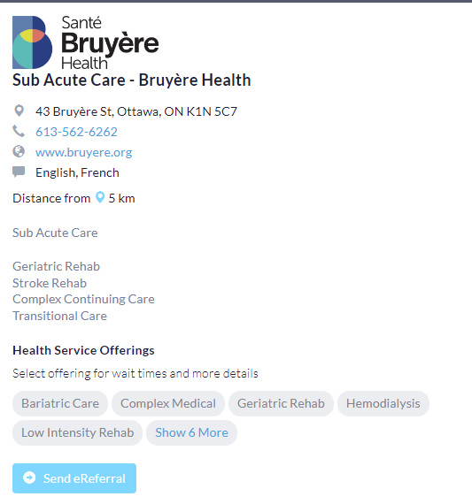

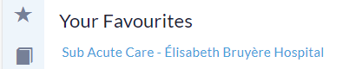
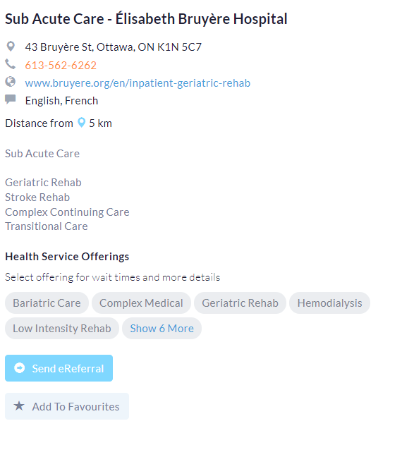
ADDING FAVOURITE REFERRAL SITES
You may save your favourite referral sites so you don’t have to search on the map or list each time you log in
From the Healthmap, search for:
  Sub Acute Care – Bruyère Health
  Hospice-Palliative Care; Bruyère Health and Hospice Care Ottawa Central Referral and Triage
  Sub Acute Care – TOH TRC
Click Add to Favourites
It will now show in your favourites each time you log on

Slide 13
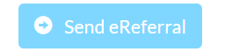
HOW DO I COMPLETE A REFERRAL
Log in to your account on Ocean
From the Healthmap, chose which program you want to apply for:
Click Send eReferral

Slide 14

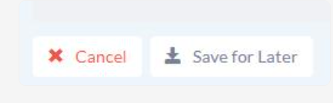
HOW TO COMPLETE THE REFERRAL
Complete the form using existing data sources
More mandatory fields than the previous SMART and RMR referrals, many of which are just yes/no questions
    If you answer YES, you must add additional information in the details box
    If you don’t know the answer, chose NO
    Please do not write “see attachment” – please complete the section with required information to support an efficient triage
You cannot submit the referral until all mandatory fields have been answered
You may add attachments
  i.e. Consent Directives, Living Wills, POA papers
  Consult and Progress Notes, MARs, DI, Labs etc.
You may save a draft of your referral to complete at a later time

Slide 15
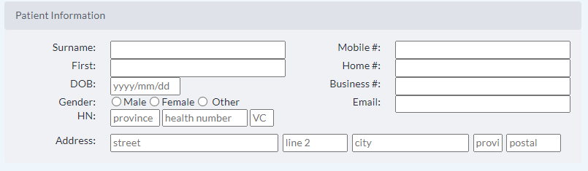
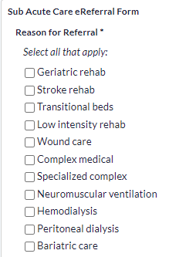
Complete all fields (only 1 of the phone number fields and email not required)
Choose only 1 program that best fits the patient’s needs / criteria
Select this for “Triaging”

Slide 16


Select “Filling out Ocean referral” to complete the referral directly in Ocean
Bruyère has access to Meditech and EPIC
TOH has access to EPIC
If you have neither EPIC or Meditech, please upload any attachments (labs, DI, consult notes, progress notes) that you normally would to support the efficient triage of a referral
Send!

Slide 17
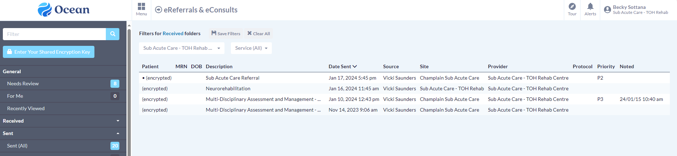
WHAT DOES OCEAN LOOK LIKE WHEN I LOG ON?
“eREFERRALS”
Section in Ocean where all your referrals live (all states)
You will be provided the Shared Encryption Key by your site administrator

Slide 18
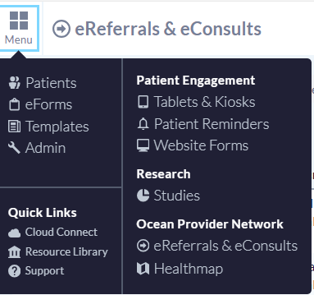
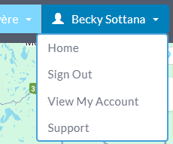
SWITCHING BETWEEN eReferrals and the Healthmap
from eReferrals – click on Menu, then Healthmap
From Healthmap, click on your name, then Home

Slide 19
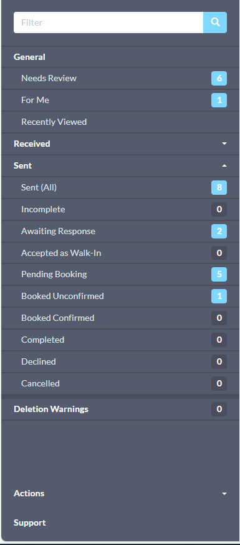
FOLDERS
GENERAL
  Where you will find instant messaging responses
RECEIVED – used by receiving site (i.e. Bruyère, TRC)
SENT
  Where all your referrals are saved
DELETION WARNINGS – generally not used
ACTIONS – generally not used

Slide 20
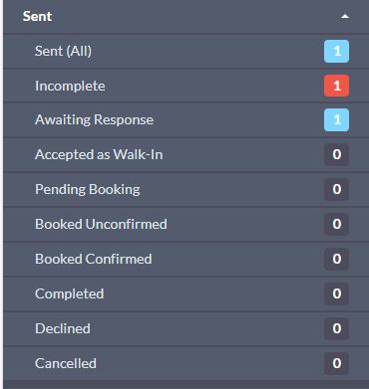
WHERE ARE MY SENT REFERRALS?
All Referrals sent
Referrals in draft mode
Referrals received but not yet registered
Not used
Referrals waiting for triage or have been accepted onto the waitlist
Patients with bed offers
All referrals that you have sent/drafted will be in the Sent folder
Patients with who have been admitted
Referrals that have been declined
Referrals that have been cancelled by sender

Slide 21
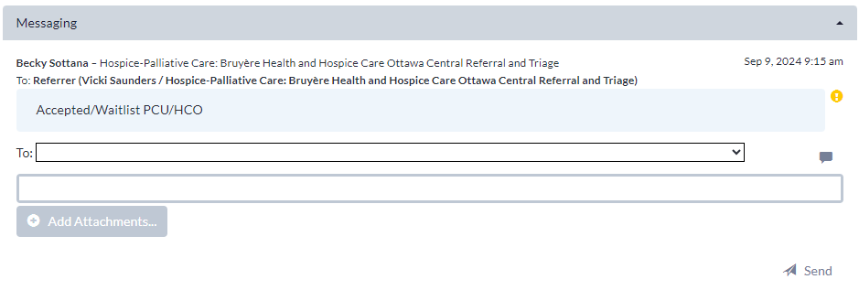


INSTANT MESSAGING: WHERE DO I FIND RESPONSES?
In your “Needs Review” folder, you will find responses from the triage team
You can reply to the triage team if more information was requested through the Messaging section by typing your message and/or adding attachments, then clicking Send.
If no response is required, click Reviewed at the bottom
RESPONSE
MESSAGE
**Only professional language is to be used as this is considered part of an EMR**

Slide 22
BED OFFERS
No change in practice ☺
Bed offers will still be given verbally to the referral source
OCEAN will track bed offers for administrative purposes only

Slide 23
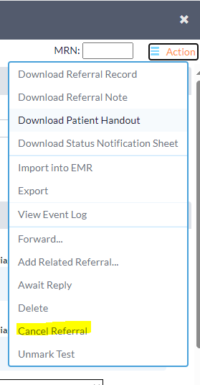
UPDATING REFERRALS
If your patient/client no longer consents, has had an acute change in medical status, has deceased or any other reason, you may cancel the referral directly in OCEAN
Open the referral from your Sent list
Under Action – select Cancel Referral and provide a reason
This sends a message directly to Bruyère/TRC
No further action required

Slide 24
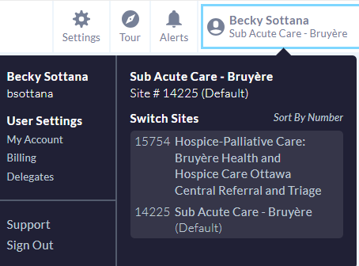
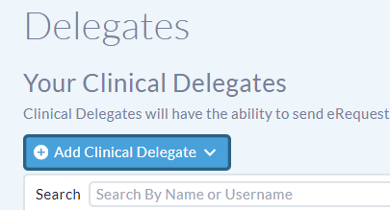
ADDING DELEGATES
If you anticipate being away, you can add delegates to your account
From the eReferrals & eConsults page, click on your name then “Delegates”
Click “Add Clinical Delegate”
Choose from the dropdown list of referral sources

Slide 25
DEMO

Slide 26
WHAT DO I NEED TO DO NOW?
Ensure you know who your site admin is
Create an OCEAN account once you get the invitation
    If you already have an account from a previous employer, you will need to create a new account with your current email address
Ensure you can log on
Familiarize yourself with the website
    Add your favourite referral sites
    Check out the eReferrals

Slide 27

WHAT IF I HAVE QUESTIONS?
generalrehab@toh.ca
Ocean – General Inquiries:
Regional Subacute Coordinated Access: Becky Sottana, becsottana@toh.ca
Bruyère Health – Admissions, 613-562-6262 ext. 4000
Clinical Questions:
Hospice-Palliative Care Central Referral and Triage: 613-562-6262 ext. 1688
Bruyère Inpatient Hospital Programs: 613-562-6262 ext. 1446
The Ottawa Hospital, Rehabilitation Centre: generalrehab@toh.ca
Ocean - Technical Issues:
contact@ereferralontarioeast.ca

